Slide 1

INTERMEDIATE PROGRAMMING LESSON
Different Ways of moving:
Synchronization, Regulated power, Ramp UP & down

Slide 2
Objectives
1) Learn about different blocks for moving the robot and when to use which block
2) Learn about power regulation, motor synchronization, and ramp up/down

Slide 3
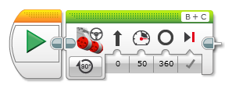



Different Ways To Move
1
How are these different from each other in terms of the following?
Power Regulation
Motor Synchronization
Ramp up/ramp down
2
3
4

Slide 4
Regulated Power
Regulated power tries to move the robot at a fixed target speed. It uses PID control internally to achieve this goal.
When the robot has trouble moving because it is heavy, it is moving uphill, its battery is dead, or it is blocked, power regulation gives more power to the motor to reach its target speed
This is good for ensuring that the robot is moving at a predictable speed
Why would you want to use unregulated power ever?
If you want the robot to push against something and stall (give up)
If you are implementing your own custom PID Control you probably don’t want the built in PID control to interfere with yours.

Slide 5
Data: Regulated Motors
Speed (Degrees/10sec)
Speed (Degrees/10sec)
Power
Power
The input to the unregulated motor block specifies the power given to the motor. The two motors perform differently at the same power because no two motors are alike (note the gap between the lines). As the battery power goes down, all speeds go down (the slope will decrease for both lines)
The input specifies speed. Power regulation adjusts power to achieve the requested speed (note that lines overlap mostly). This works up to the limit (max speed) of each individual motor (note lines split at max power). This is true regardless of battery level. The max speed will decrease at lower battery levels but the slope will stay the same.

Slide 6
Synchronized Motors
Synchronized motors makes sure that both motors turn the same amount (or at some fixed ratio)
If one wheel gets stuck, it prevents the other wheel from spinning
If you have the motors turning the same amount, it helps ensure that the robot moves straight when one wheel is slowed by friction or anything else
When you have synchronized motors with a ratio, it makes the robot make predictable and smooth turns
Videos on next slide

Slide 7
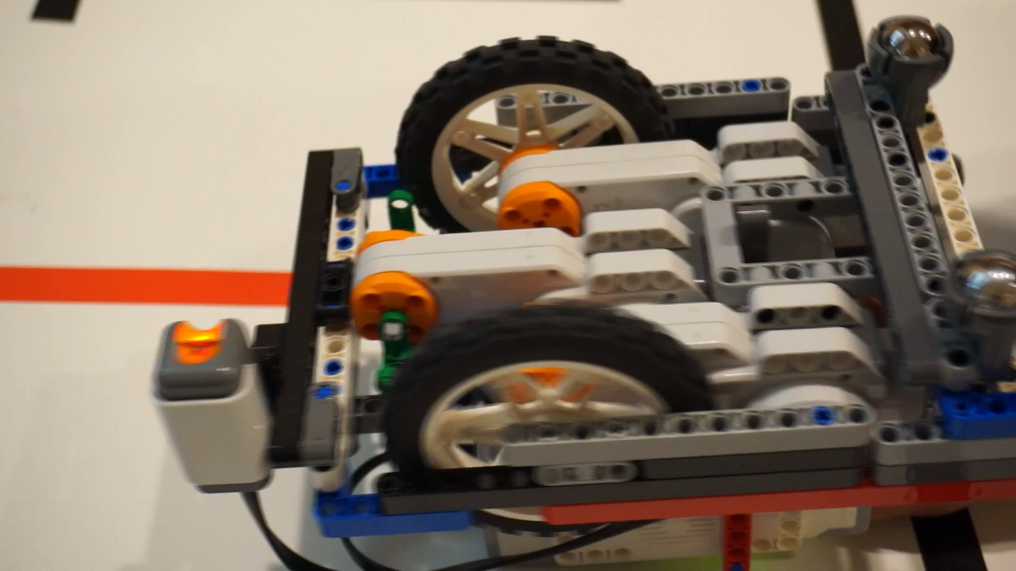
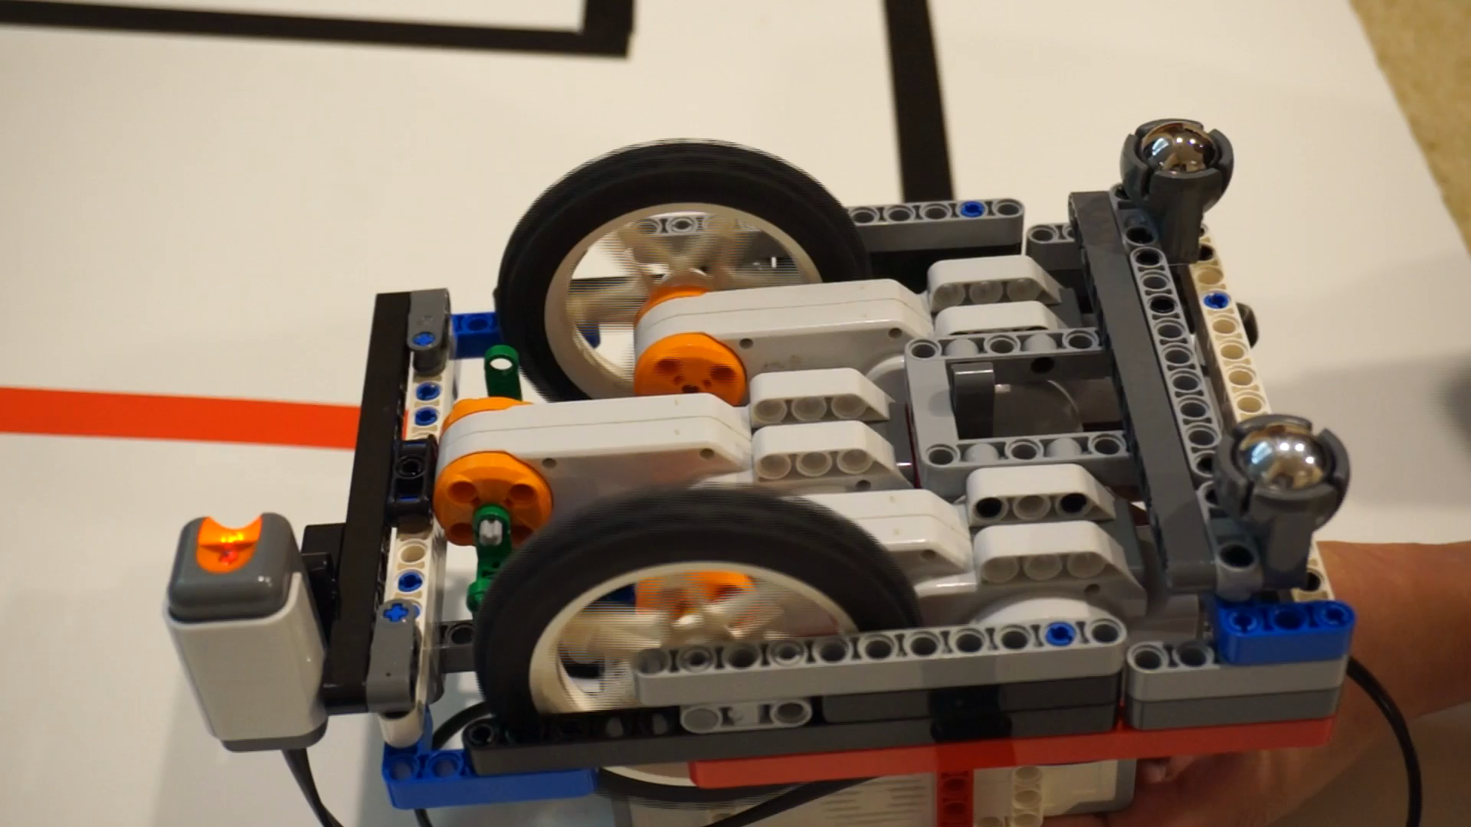
Synchronized vs. Unsynchronized
Click to Watch Videos
Synchronized motors
One motor getting stuck causes other motor to stop
Unsynchronized motors
Second motor continues when first gets stuck

Slide 8
Data: Synchronized Motors
Speed (Degrees/10 sec)
Speed (Degrees/10 sec)
Power
Power
Both motors go the same distance. The two lines overlap.
One motor is not able to keep up with the other. But this isn’t fixed because they are unsynchronized.

Slide 9
Ramp Up / Ramp Down
Ramp up makes the robot speed up gradually at the beginning of a move
Ramp down makes the robot brake gradually at the end
Without ramp up/ramp down you might see the robot jerk at the beginning or end
The robot will still adjust its motors after a brake to reach that target rotation sensor value but this may still be less accurate

Slide 10
Data: Ramping Up/Down
Move 2 rotations (green line) incorporates ramp up and ramp down to nicely stops after 2 rotations.
Move + Wait (orange line) has a hard stop which causes the robot to go past 2 rotations and then back up (notice the bump in the graph)
bump
Degrees
Time
Move + Wait
Move 2 rotation

Slide 11


Different Ways To Move
 |  |  | Regulated Power | Synchronized Motors | Ramp Up / Ramp Down
 |  |  | ✔ | ✔ | ✔
 |  |  | ✔ | ✔ | ✔
 |  |  | ✔ | ✗ | ✗
 |  |  | ✗ | ✗ | ✗
1
2
3
4

Slide 12
Moving Degrees vs. Seconds
Move Degrees/Rotations
Block does not complete until the target degree rotation is reached
So what if the robot gets stuck somewhere on the mat?
Program stalls and never goes to next block
You will have to save the robot and take a touch penalty
Move Seconds
Less accurate for robot movement
Distance traveled depends on speed, battery level, weight of robot
You have to remember this when deciding if move secs should be used.
However, can help avoid stalls
E.g. Can be useful if your attachment arm gets stuck
Videos on next slide

Slide 13
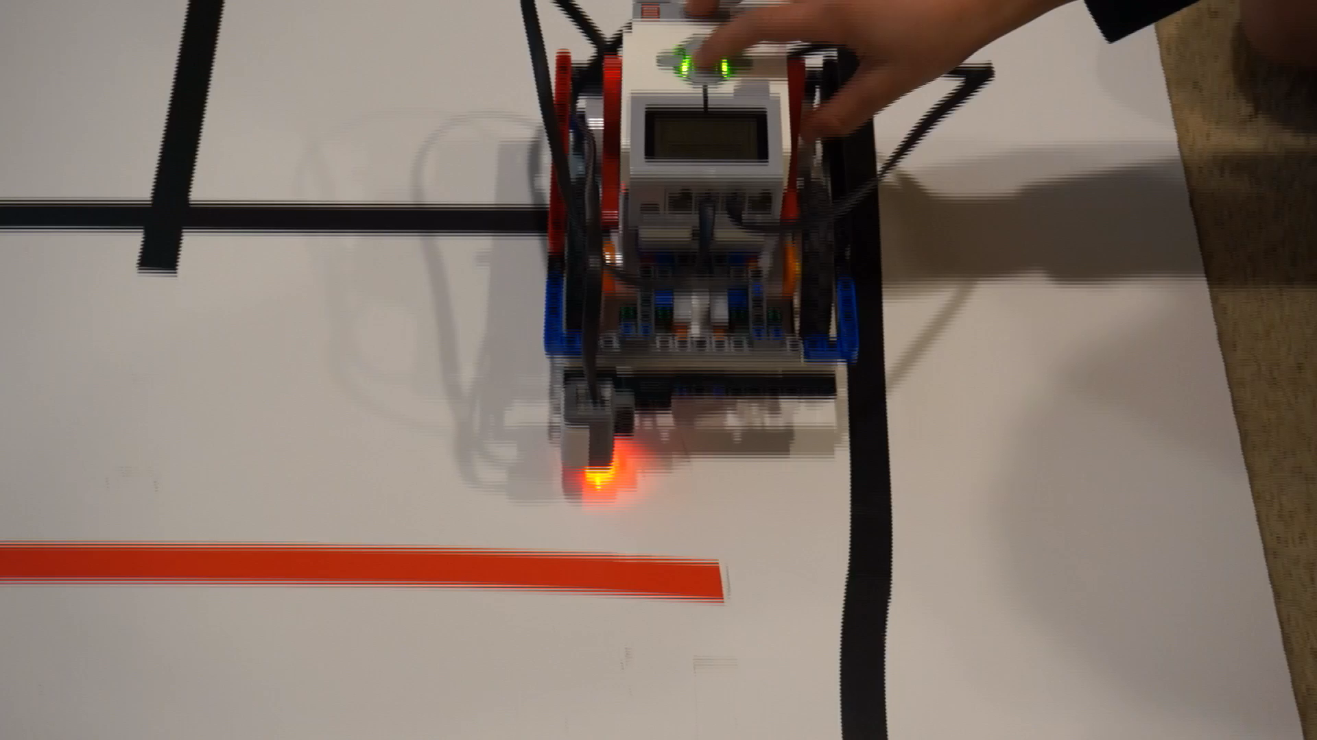
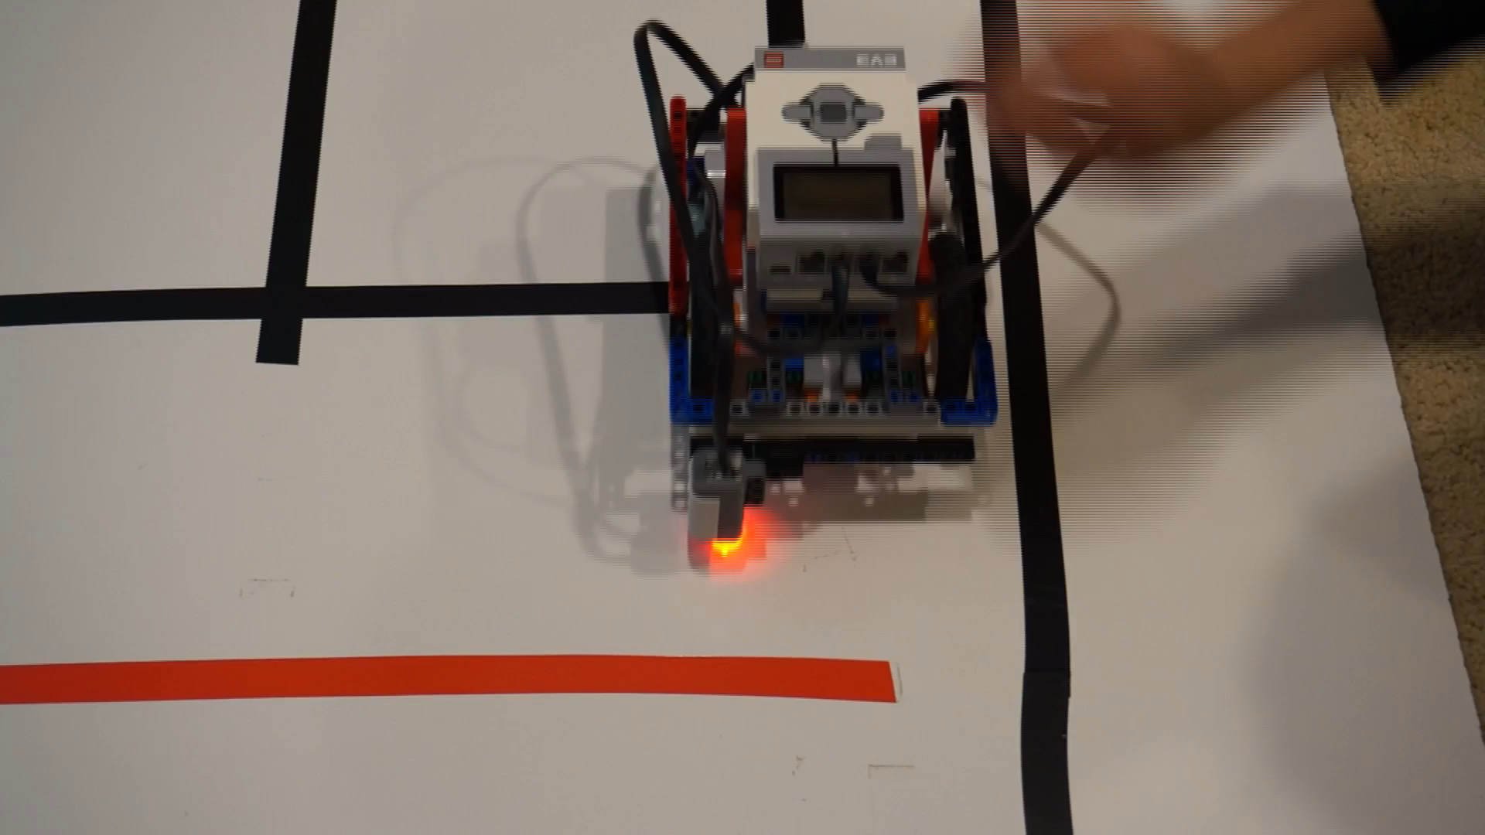
Moving Degrees vs. Seconds
Click to Watch Videos
Stalled Robot
Robot gets stuck. Finishes only when released.
Unstalled Robot
Robot gets stuck but still finishes (you can hear the sound)

Slide 14
Discussion Guide
 |  |  | Regulated Power | Synchronized Motors | Ramp Up / Ramp Down
Fill in the chart below:
1
2
3
4

Slide 15
Credits
This tutorial was created by Sanjay Seshan and Arvind Seshan
More lessons are available at www.ev3lessons.com
This work is licensed under a Creative Commons Attribution-NonCommercial-ShareAlike 4.0 International License.

